Slide 1
MA206 – Probability and Statistics Lesson 20 – Linear Regression

Slide 2
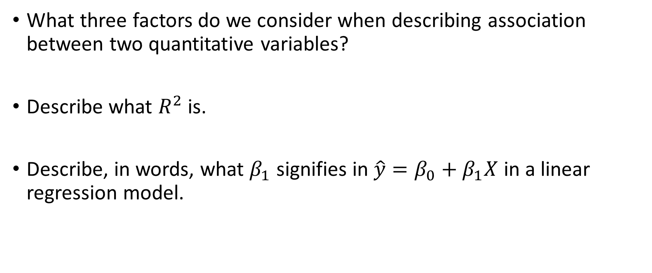
Review
What three factors do we consider when describing association between two quantitative variables?
Describe what $R^{2}$ is.
Describe, in words, what $β_{1}$ signifies in $\hat{y}=β_{0}+β_{1}X$ in a linear regression model.
Notes:
Form, Direction, and Strength
$R^{2}$ is the amount of variation in the response variable explained by our model
For every unit change in the variable X, we expect the response variable Y to change by $β_{1}$.

Slide 3
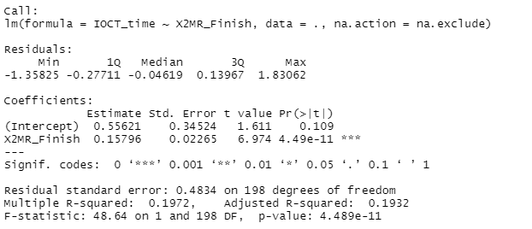


Reading the R Output
H₀: There is NO association between explanatory and response variable
H_{a}: There IS an association between explanatory and response variable
$$β_{1}=0$$
$$β_{1}≠0$$

Slide 4




Reading the R Output
H₀: There is NO association between explanatory and response variable
H_{a}: There IS an association between explanatory and response variable
Response
Explanatory
$$β_{1}=0$$
$$β_{1}≠0$$
P-value = 4.49x10⁻¹¹
$${\hat{β}}_{1}=0.15796$$
$$t−stat=6.974$$
$$R^{2}=.1972$$
SE(${\hat{β}}_{1}$)

Slide 5
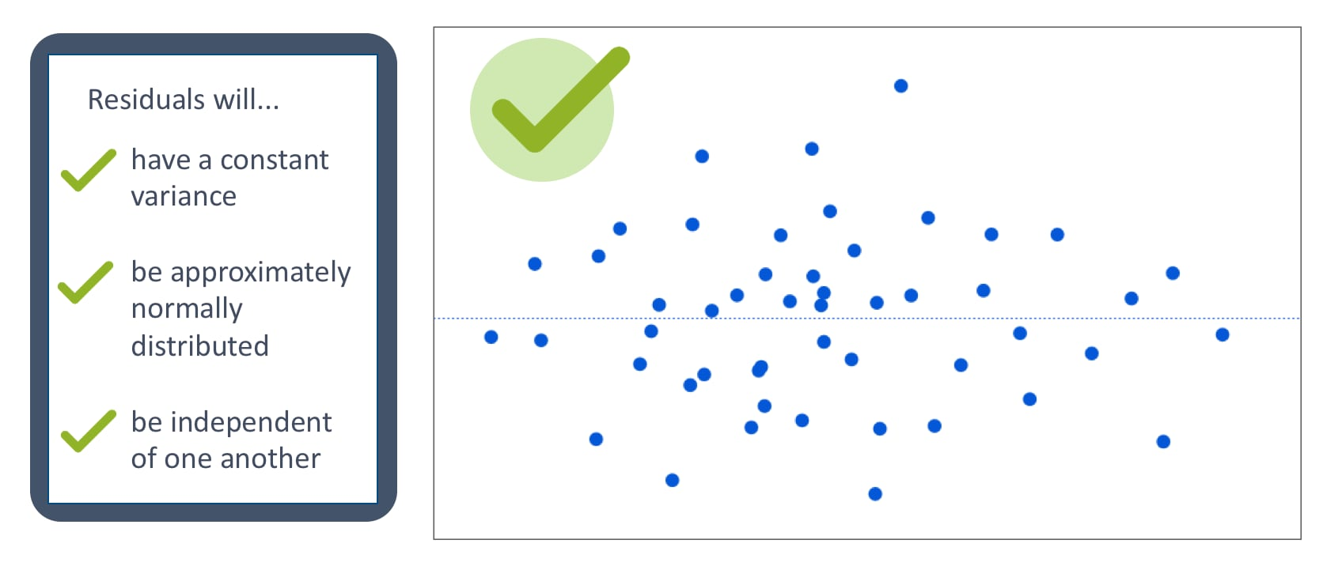
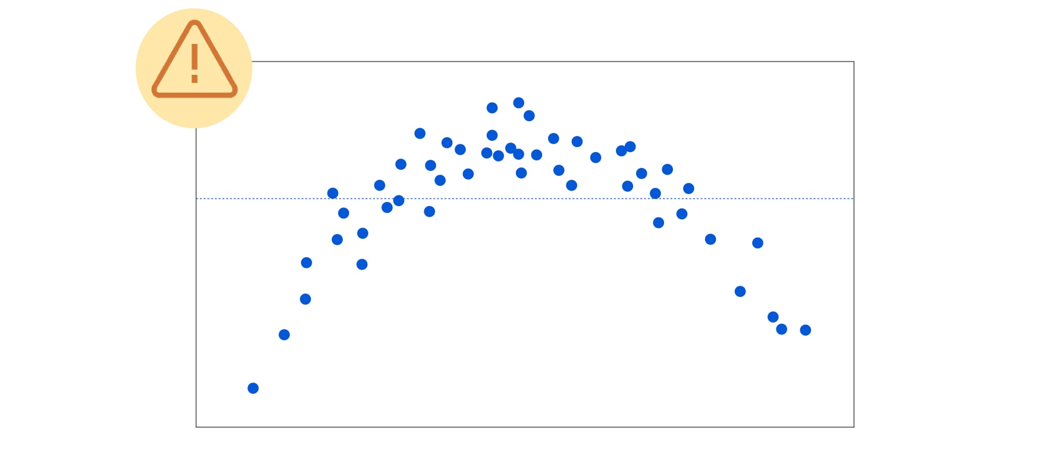
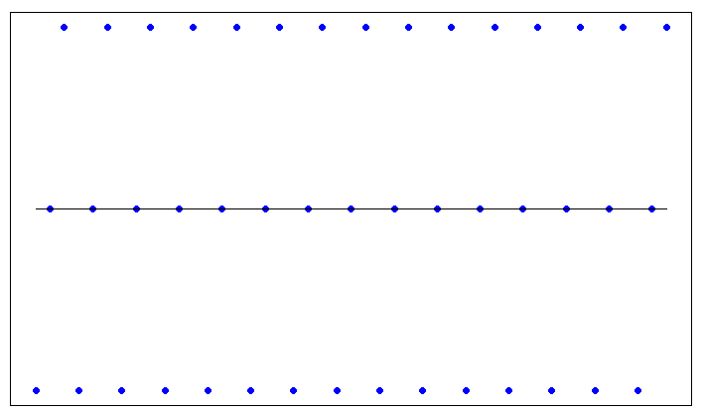
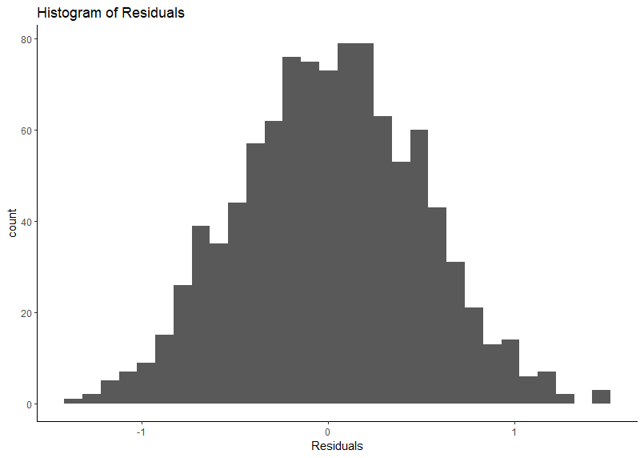
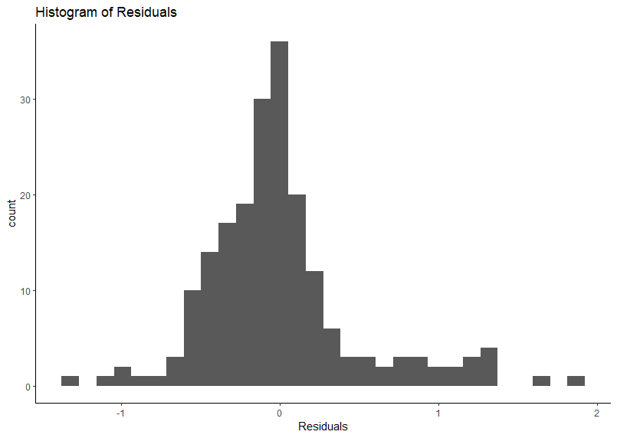
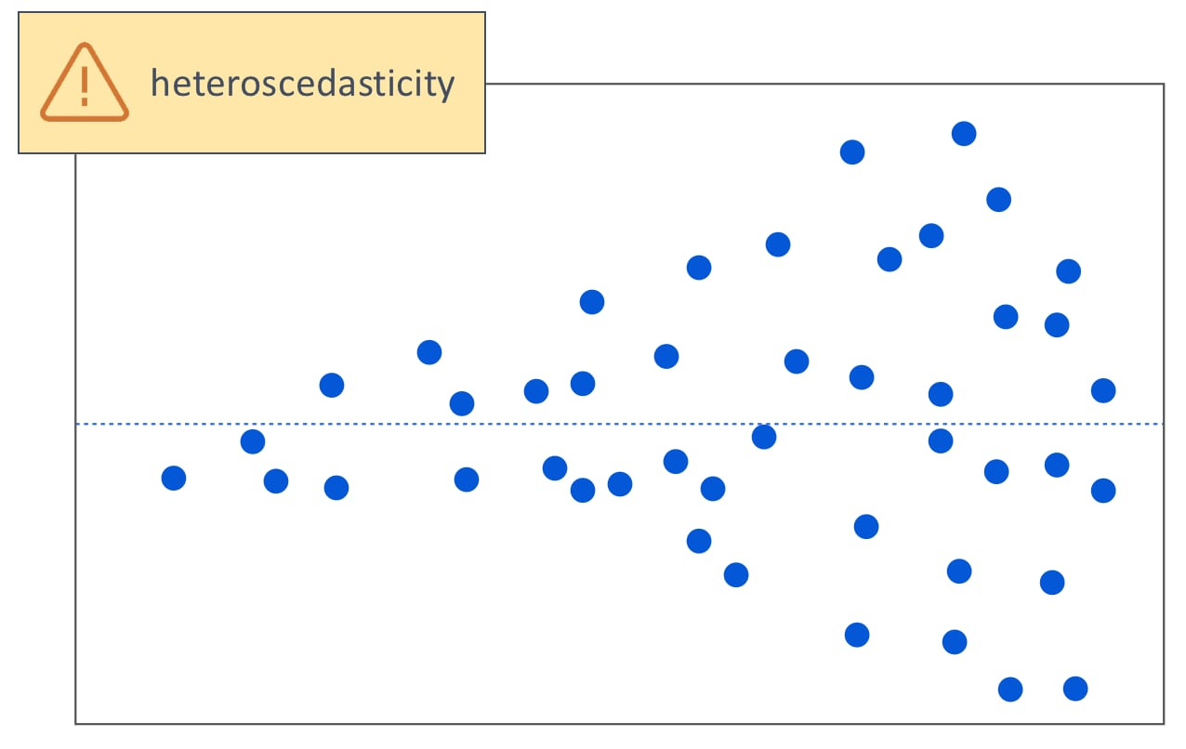
Validity Conditions
Linearity
Independence
Normality
Equal Variance

